Slide 1


Expanding the Circle of Success ™
Helping Manifest Bucky’s Vision of “Betterment for 100% of Humanity”
An Invitation to Help Solve Social, Economic and Environmental “Ultimate Success Puzzles” by Combining Benefit Corporations, Crowdfunding and Community Economic Development

Slide 2
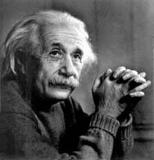
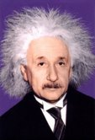
Expanding the Circle of Success
Will Help Shift Consciousness
“The significant problems we have cannot be solved at the same level of thinking (consciousness) with which we created them” -- Albert Einstein

Slide 3
Our Strategy is to Establish a Network of CED Benefit Corporations, B Corps and
Non-profit CAN DO! CED Resource Centers
The recently passed JOBS Act creates Crowdfunding opportunities, eases IPO rules, and will let businesses advertise and raise equity capital from non-accredited investors. It also allows non-accredited investors to invest in these companies based upon
a percentage of their income.
We’re combining the Principles and Practices of Community Economic Development (CED) with the new Benefit Corporation model and the Crowdfunding provisions of the JOBS Act to help foster innovation, collaboration, job creation, enlightened entrepreneurship, and sustainable communities.
www.cedbcorp.com

Slide 4
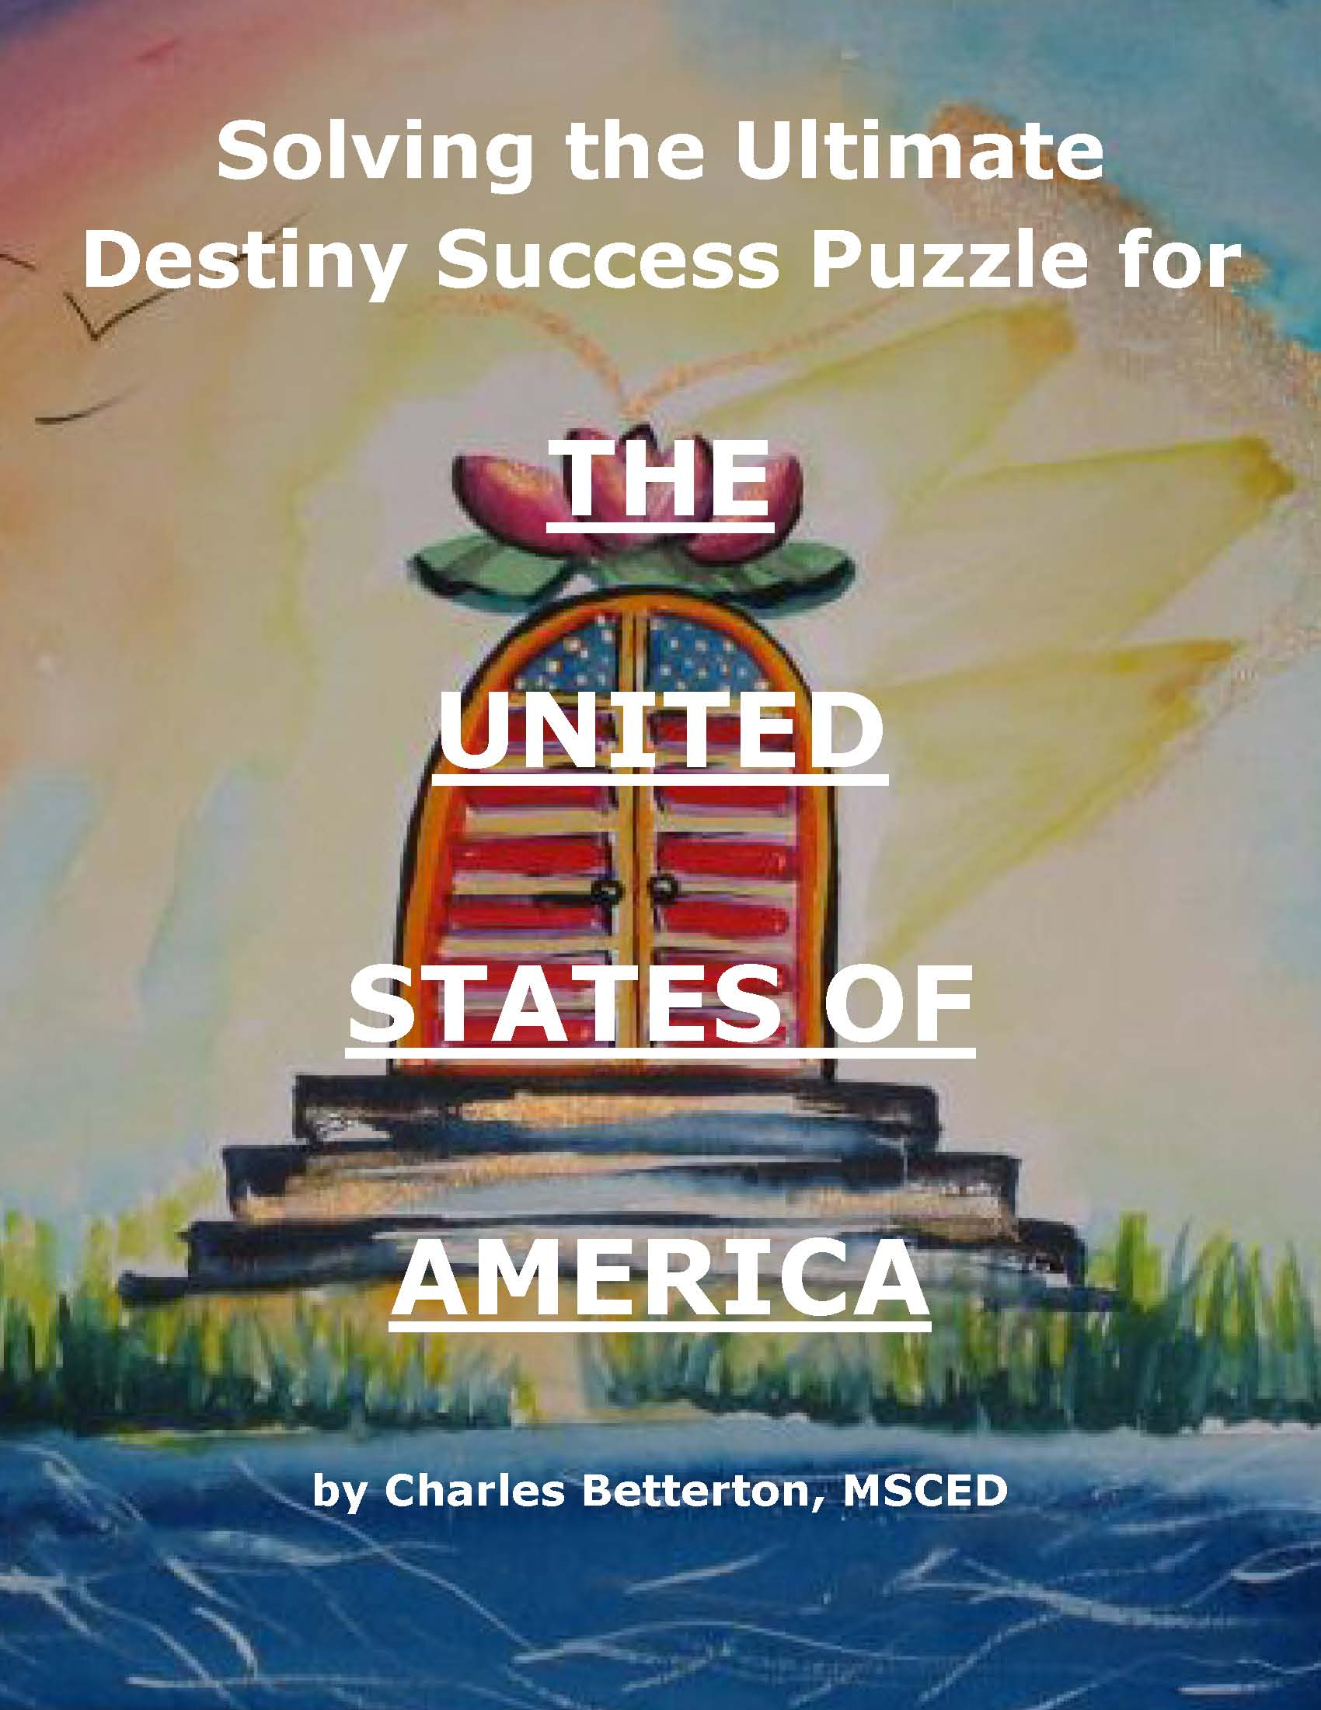
Our Ultimate Project Goals Are To Help:
(1) Individuals, organizations and communities actualize more of their potential to solve social, economic
and environmental challenges.
(2) Manifest Bucky Fuller’s vision of betterment for 100% of humanity.
(3) Fulfill the ultimate destiny of the USA that Benjamin Franklin said was not power but light (enlightenment).
(4) Demonstrate cause-oriented values and principles in business enterprises
www.ultimatedestinyoftheusa.info

Slide 5
Benefit Corporations and B Corps Are
Designed to Help “Expand the Circle of Success”
Benefit Corporations are a new class of cause-oriented corporation that create a material positive impact
on society and the environment
26 States & DC have passed legislation:
Arizona, Arkansas, California, Colorado, Connecticut, Delaware, Florida, Hawaii, Illinois, Louisiana, Maryland, Massachusetts, Minnesota, Nebraska, Nevada, New Hampshire, New Jersey, New York, Oregon, Pennsylvania, Rhode Island, South Carolina, Utah, Vermont, Virginia, Washington, DC, West Virginia
Legislation is pending in:
Alaska, Alabama, Georgia, Idaho, Indiana, Iowa, Kansas, Kentucky, Michigan, Ohio, Puerto Rico, Wisconsin
Certified B Corps are a new type of corporation which uses the power of business to solve social and environmental problems.
B Corporations are a diverse community with one unifying goal:
to redefine success in business
There are over 1,000 Certified B Corporations across 60 different industries. www.bcorporation.net
www.cedbcorp.com/benefit_corporation.htm

Slide 6
Community Economic Development
Community Economic Development (CED) consists of three main principles: Self-Help; Empowerment; and Capacity Building.
CED strategies include issues such as:
Local ownership of economic resources;
Maximizing citizen participation; and
Building the capacity of people to participate in and manage the development process.
www.CommunityEconomicDevelopmentResourceCenters.com

Slide 7
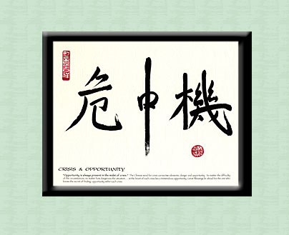
The Ultimate Question These Days Is:
Given the global social, economic and environmental crises, what attitudes and skills can help us discover and apply more positive, creative, and sustainable approaches and strategies?
Opportunity is always present in the midst of crisis.
www.UltimateSuccessPuzzle.com

Slide 8
The Answers to the Question = Ultimate
Successful Living Skills for the 21st Century
Awakening to our spiritual identity
Realizing more of our inherent potential
Harnessing our creative mind power
Flowing our energy to solutions rather than problems
Remembering who we really are and why we are here
Fulfilling our life purpose and mission
Making a difference and leaving a legacy
Loving, serving, and blessing others
Maintaining a positive mental attitude
Applying creative thinking and problem solving
Manifesting stewardship over the rich talents and
treasures entrusted to us by God/Spirit/Source/Creator
www.SuccessfulLivingSkillsForThe21Century.com

Slide 9
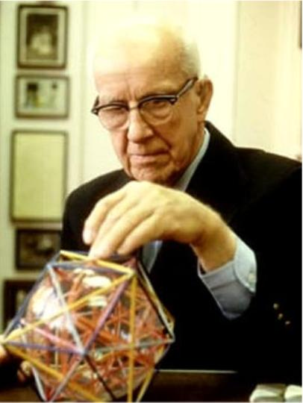
Betterment for 100% of Humanity Is Now Possible
“For the first time in history it is now possible to take care of everybody at a higher standard of living than any have ever known. All humanity now has the option to become enduringly successful.” -- R. Buckminster Fuller
The Buckminster Fuller Institute
www.bfi.org

Slide 10
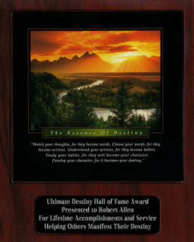
Sharing Successful Living Skills for 21st Century
In addition to providing training
on Benefit Corporations, Crowd- funding and Community Economic Development, the network of Resource Centers will provide training programs from Ultimate Destiny Hall of Fame Award recipients and other experts on:
Successful Living Skills,
Enlightened Entrepreneurship,
Social Entrepreneurship,
and Infopreneurship.
www.UltimateDestinyHallOfFameAward.com

Slide 11
Start Up Approach and Implementation
Universal StewardHeirShip, Inc. (USI) and the Community Economic Development Resource Center, Inc. (CEDRC) are incorporating the initial CED Benefit Corporations and will retain at least 10% to 20% ownership.
Each new Company will allocate at least 10% of their shares
to non-profits. The balance of shares will be owned by the individuals, businesses, non-profits, and governmental entities that serve as cofounders and investors in each new Company.
Invitations to participate are being shared with Social Venture Network, World Business Academy, private foundations that provide Program Related Investments, and government agencies such as HUD, HHS, etc.
www.universalstewardheirship.com www.cedbcorp.com

Slide 12
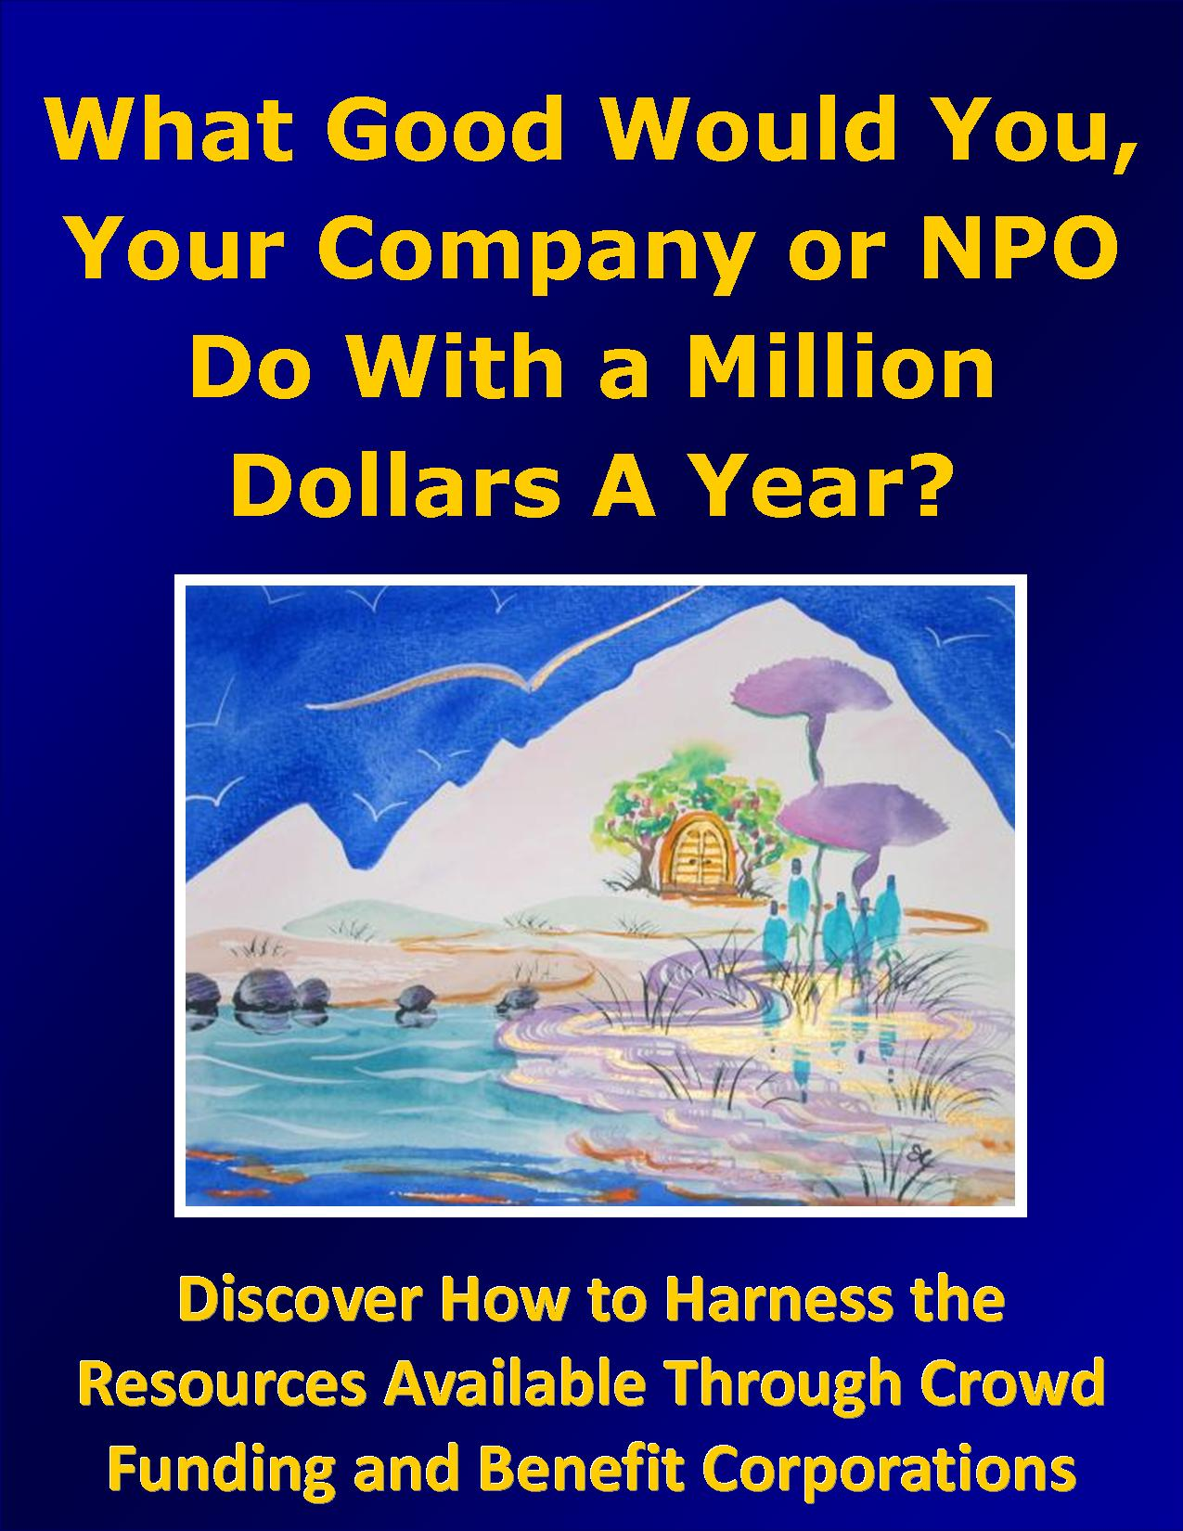
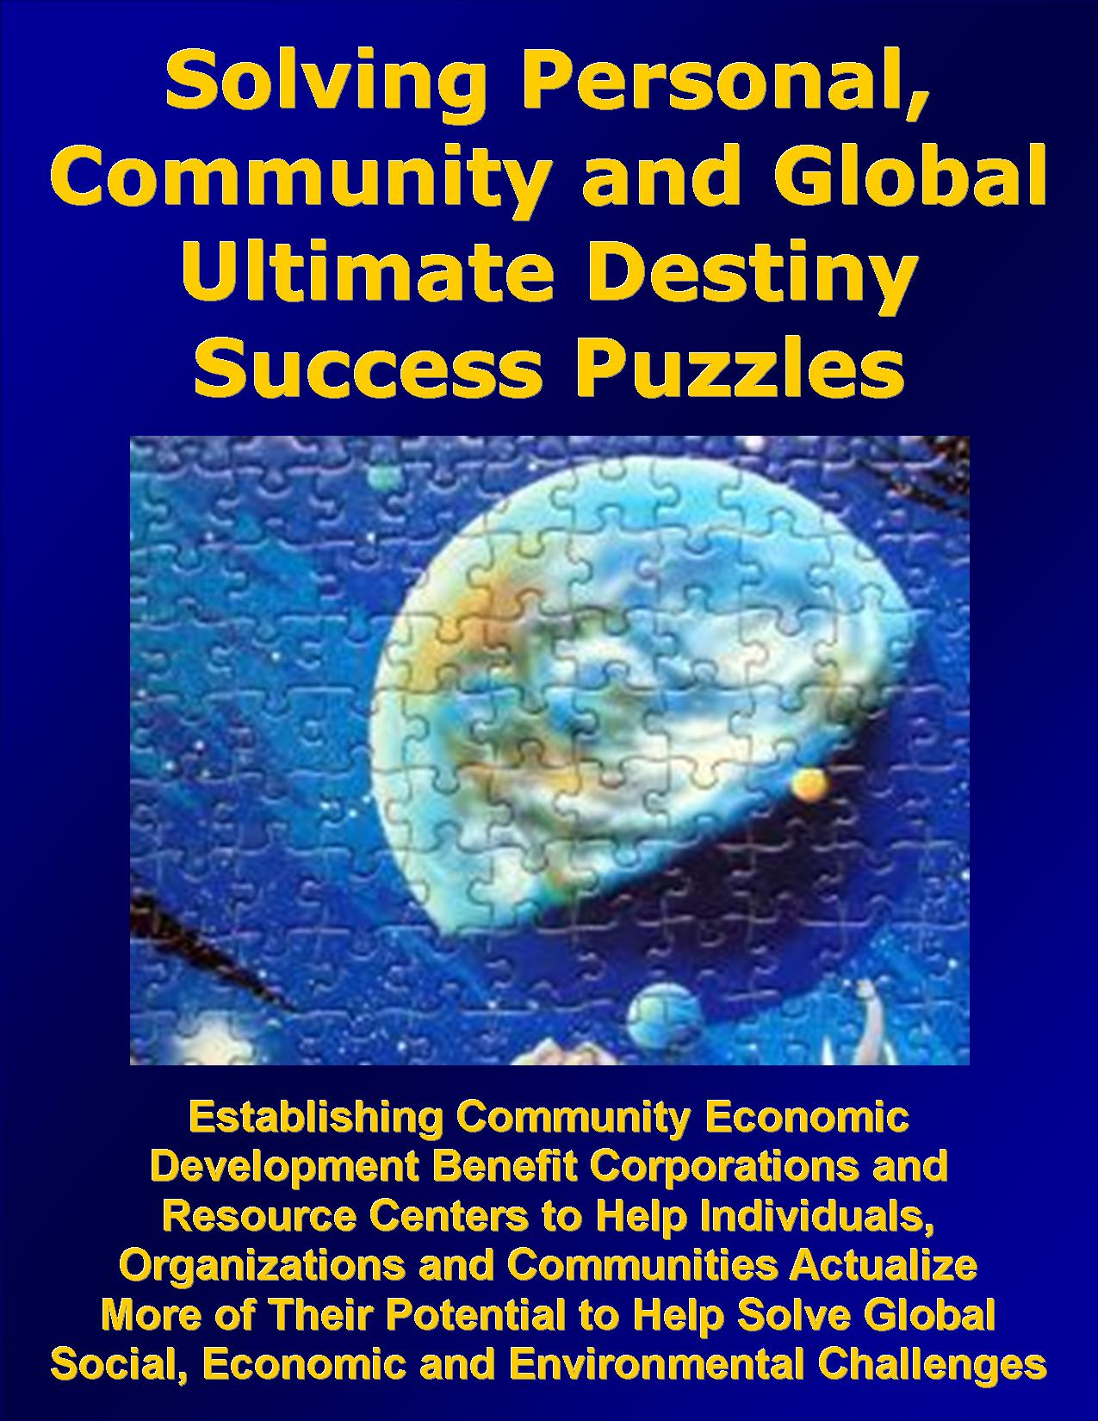
Examples of Several Introductory Publications
www.CEDBCORP.com
www.UltimateSuccessPuzzle.com

Slide 13
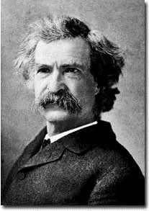
"Inherently, each one of us has the substance within to achieve whatever our goals and dreams define. What is missing from each of us is the training, education, knowledge and insight to utilize what we already have.” – Mark Twain

Slide 14
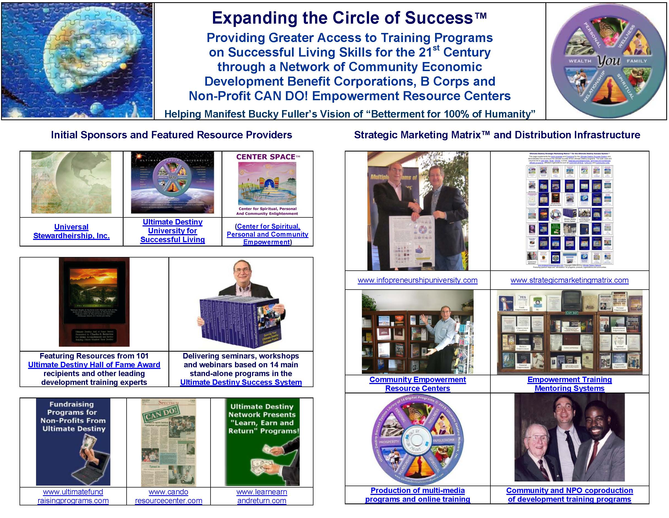

Slide 15
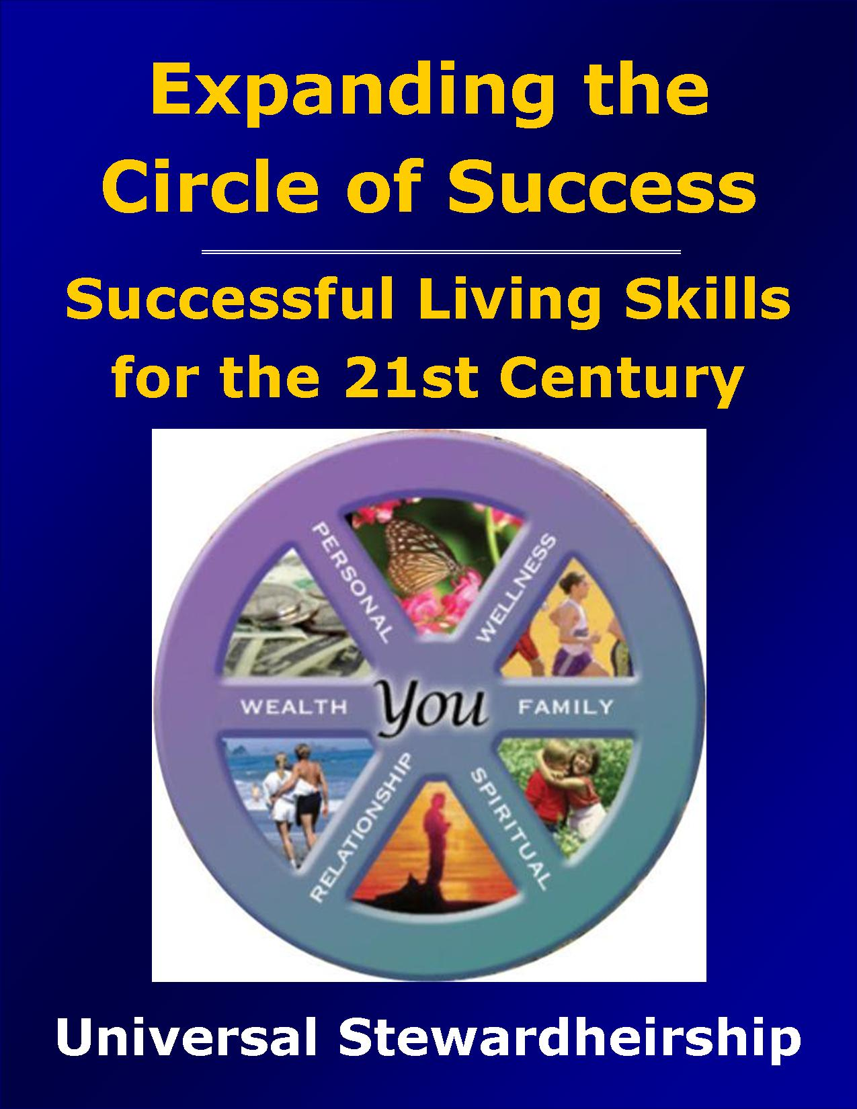
More Examples of Introductory Publications
www.ExpandingTheCircleofSuccess.org
www.UltimateDestinyOfTheUSA.info

Slide 16
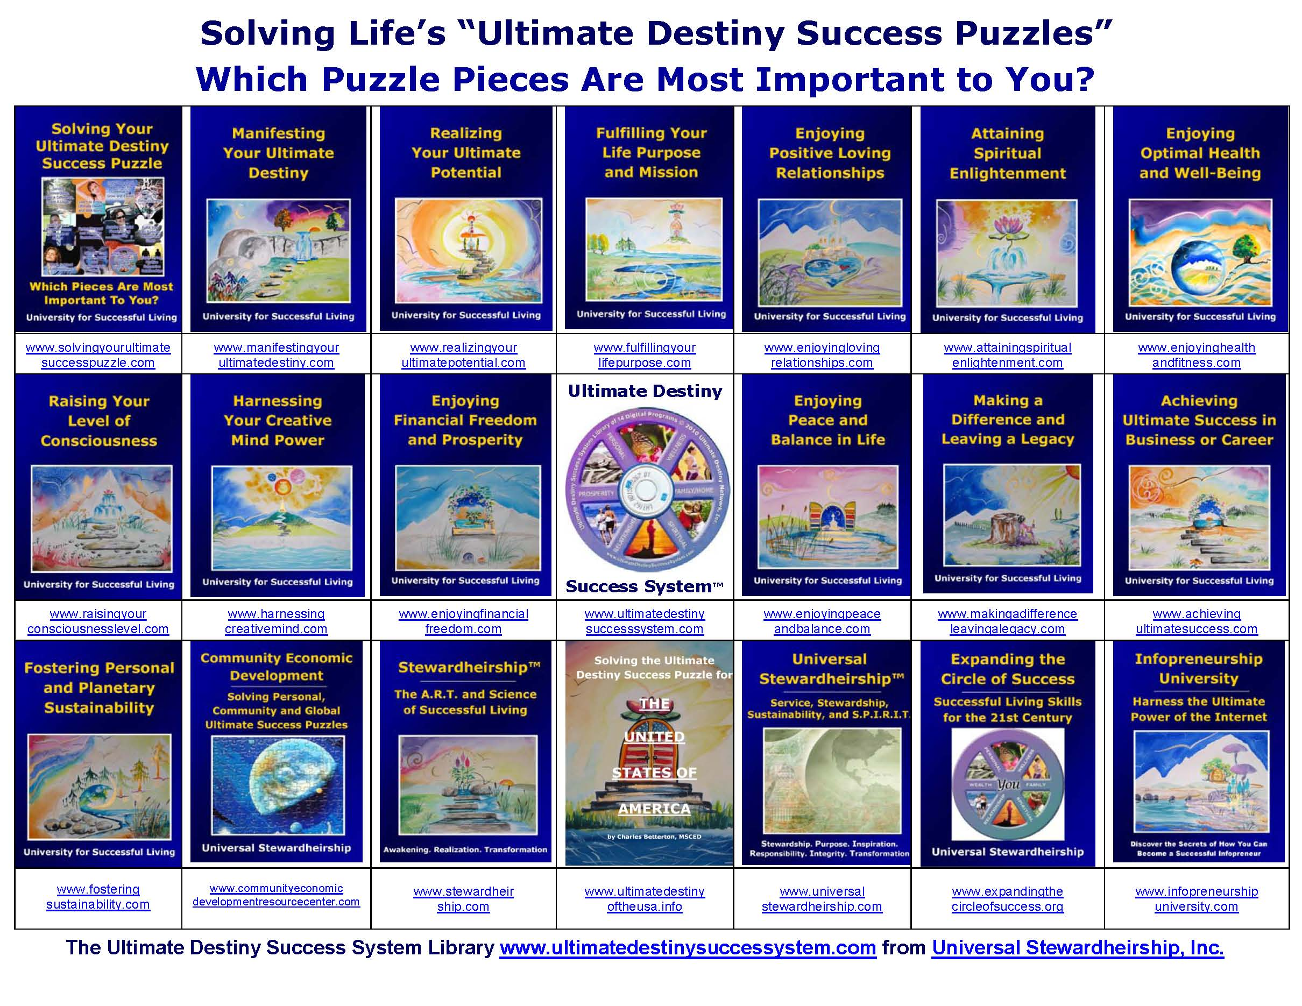

Slide 17
We’ve Already Identified the
Primary Distribution Network
10,000 + Empowerment Resource Centers ™
3,000 New Thought Centers, INTA, AGNT etc.
Federal Agencies like HUD and HHS
3,500 Indian and Public Housing Authorities and Resident Organizations
5,000 United Way’s and Agencies
3,500 Community Development
Corporations and Action Agencies
500,000 Possible
Sponsors

Slide 18
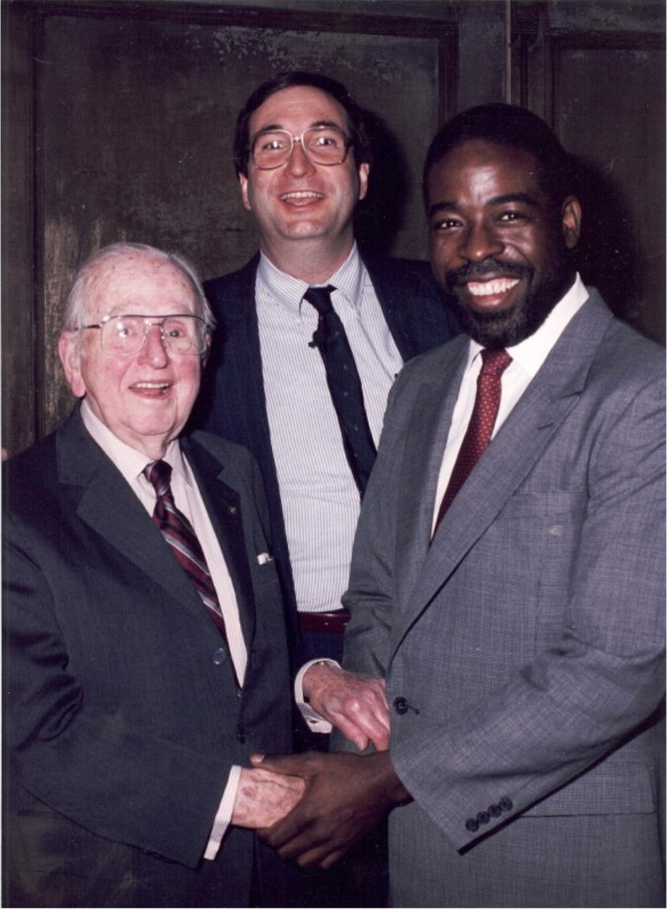
Les Brown--Helping Expand the Circle of Success
“The innovative community empowerment model that Charles Betterton created has evolved since 1990 when he produced the first Community Unity Celebration with Norman Vincent Peale and me into an enlightened entrepreneurship program that helps ‘Expand the Circle of Success.’ I have enjoyed working with Charles several times helping him implement his award-winning CAN DO! programs for youth and ‘disadvantaged populations’ and I proudly support this project.” -- Les Brown
www.candoresourcecenter.com www.communityresourcecenters.org

Slide 19
Many Asians Have 50-100 Year Plans
Given the scope of our ultimate vision,
we decided to experiment with a 300
year plan based on the following quote:
“The acquisition of wealth is no longer the driving force in the 24th century. We work to better ourselves and better all of humanity.” – Captain Picard First Contact (Star Trek)

Slide 20
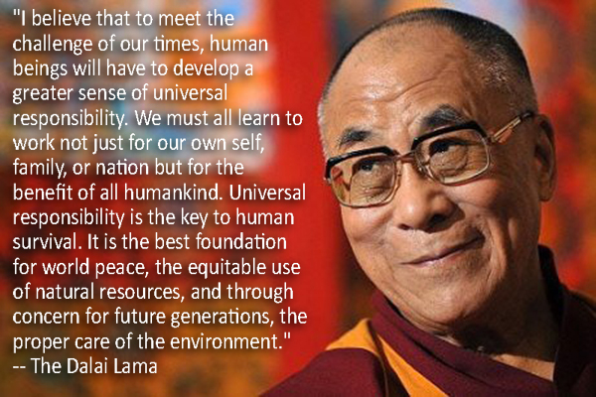
Universal Responsibility

Slide 21
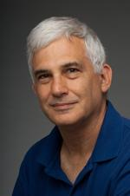
Dr. Michael Swack
“Charles Betterton's project for the 1990-1992 Community Economic Development Master's program was to establish a National CED Resource Center. In 1998, he turned down a HUD Community Builder Fellowship worth about $250,000 to continue his non-profit community empowerment work.” “As one of his faculty advisors 22 years ago, I am grateful for the opportunity to participate in helping ‘Dr. Bettertown’ continue with this project which is needed today more than ever before.” Michael Swack, Ph.D. Professor, the Carsey Institute, University of New Hampshire and founding Dean, School of Community Economic Development, Southern New Hampshire University

Slide 22
We invite your participation in whatever way best serves you!
Help Expand the Circle of Success as a Charter Member
Help create a B Corp or Benefit Corporation in your area
Participate as a Sponsor/Donor
of the CED Resource Center
Sponsor a CED Resource
Center in your community
Become a Featured Resource Provider, Coach or Mentor
Participate as a Strategic
Alliance or Marketing Partner
Serve as a Board and or
Advisory Board Member
Become an Investor and
or Revenue Share Partner
Provide a grant, donation or Program Related Investment
Help Co-produce or Sponsor
CED Empowerment Events
www.CEDBCORP.com/invitation.htm

Slide 23
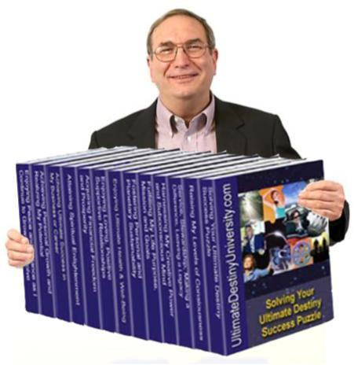
For More Information Contact:
Community Economic
Development Resource Center, Inc.
C/O Universal StewardHeirShip, Inc.
PO Box 20072, Sedona, AZ 86341
www.CommunityEconomicDevelopmentResourceCenters.com
Charles Betterton, MSCED
CEO@cedbcorp.com
928-554-4715

