Slide 1
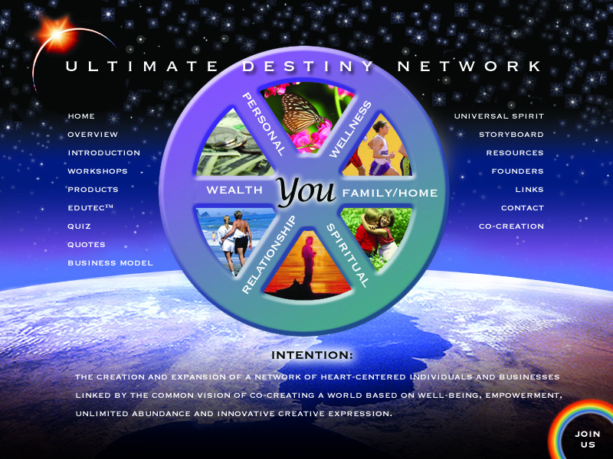
Ultimate Destiny Network

Slide 2


Slide 3

Solving Our Personal, Community
and Global Success Puzzles

Slide 4
Know Thyself!
The First Step in Discovering and Manifesting Your Ultimate Destiny
Who are you?
Why are you here?

Slide 5
What would you say are the most important “successful living skills”?

Slide 6
Positive Mental Attitude
Goal Oriented
Self Motivated
Effective Time Management
Effective Money Management
Paul J. Meyer companies
discovered five success skills:

Slide 7
Community Economic Development
The field of community economic development includes a focus on:
self-help, empowerment and
capacity building.

Slide 8
CED brainstorming on the root causes
of the problems that threaten our society
The me generation
Getting away from God/Spirit/Creator/Source
Lack of spirituality
Lack of common vision
Absence of wisdom
Focus on accumulation versus circulation
Spiritual and cultural disintegration and the
Lack of an appropriate value system and
ways to express it

Slide 9
Values of Community Economic Development Principles
Spiritual underpinning, a sense of oneness
Application of cooperative principles
A focus on human development
Retention of wealth in the neighborhoods
Setting personal goals with consideration of the
community and larger society
Consideration of multicultural differences in religion,
values perspectives and communication and
Enabling people and communities to empower
themselves

Slide 10
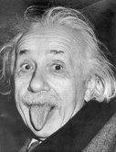
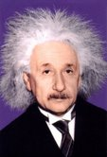
“The significant problems we have
cannot be solved at the same level
of thinking (consciousness) with
which we created them”
Albert Einstein

Slide 11

Where are you on the
Enlightenment Ladder?

Slide 12
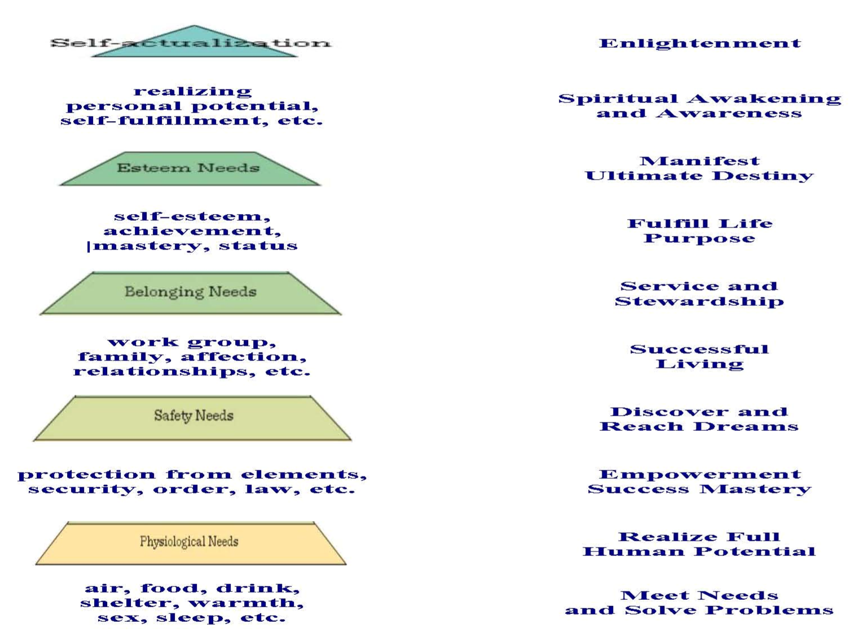
Where are You Right Now on
Maslow’s Hierarchy of Needs?

Slide 13
Where Are You on the Map of Consciousness from Power Versus Force by David Hawkins?
God-view | Life-view | Level | Log | Emotion | Process
Self | Is | Enlightenment | 700-1000 | Ineffable | Pure Consciousness
 |  | ↑
All-Being | Perfect | Peace | 600 | Bliss | Illumination
 |  | ↑
One | Complete | Joy | 540 | Serenity | Transfiguration
 |  | ↑
Loving | Benign | Love | 500 | Reverence | Revelation
 |  | ↑
Wise | Meaningful | Reason | 400 | Understanding | Abstraction
 |  | ↑
Merciful | Harmonious | Acceptance | 350 | Forgiveness | Transcendence
 |  | ↑
Inspiring | Hopeful | Willingness | 310 | Optimism | Intention
 |  | ↑
Enabling | Satisfactory | Neutrality | 250 | Trust | Release
Permitting | Feasible | Courage | 200 | Affirmation | Empowerment
Indifferent | Demanding | Pride | 175 | Scorn | Inflation
 |  | ↓
Vengeful | Antagonistic | Anger | 150 | Hate | Aggression
 |  | ↓
Denying | Disappointing | Desire | 125 | Craving | Enslavement
 |  | ↓
Punitive | Frightening | Fear | 100 | Anxiety | Withdrawal
 |  | ↓
Disdainful | Tragic | Grief | 75 | Regret | Despondency
 |  | ↓
Condemning | Hopeless | Apathy | 50 | Despair | Abdication
 |  | ↓
Vindictive | Evil | Guilt | 30 | Blame | Destruction
 |  | ↓
Despising | Miserable | Shame | 20 | Humiliation | Elimination

Slide 14
Where Are You on the Scale of Emotions from Ask and It Is Given: Learning to Manifest
Your Desires by Ester and Jerry Hicks
A scale of your emotions would look something like this:
Joy/Knowledge/Empowerment/Freedom/Love/Appreciation
Passion
Enthusiasm/Eagerness/Happiness
Positive Expectation/Belief
Optimism
Hopefulness
Contentment
Boredom
Pessimism
Frustration/Irritation/Impatience
Overwhelment
Disappointment
Doubt
Worry
Blame
Discouragement
Anger
Revenge
Hatred/Rage
Jealousy
Insecurity/Guilt/Unworthiness
Fear /Grief/Depression/Despair/Powerlessness

Slide 15
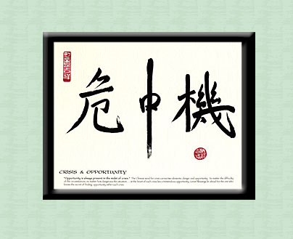
Crisis and Opportunity Preparedness Resources
Opportunity is always present in the midst of crisis.
Given the global economic and environmental challenges, what attitudes and skills can help us discern and apply more positive, creative and conscious sustainable approaches?
www.CrisisAndOpportunityPreparedness.com

Slide 16
Examples of Successful Living
Skills for the 21st Century
Clarity of and Shared Vision
Strategic Planning
Goal Setting in Larger Context
Resourcefulness & Ultimazation
Motivation of Self and Others
Effective Communication
Positive Mental Attitude
Stress Management
Team Building
Leadership
Multi Media and E-publishing
Love and Forgiveness
Stewardship Consciousness
Master Mind Groups
Meditation & Relaxation
Partnership Building
Networking Ability
Internet Marketing
Conflict Resolution
Conscious Money Management
Creative Thinking
Problem Solving

Slide 17
Ultimate Successful Living Skills for the 21st Century
Awakening to our spiritual identity.
Realizing more of our inherent potential.
Harnessing our creative mind power.
Flowing our energy to solutions rather than problems.
Remembering who we really are and why we are here.
Fulfilling our life purpose and mission.
Making a difference and leaving a legacy.
Loving, serving and blessing others.
Maintaining a positive mental attitude.
Applying creative thinking and problem solving.
Manifesting stewardship over the rich talents and
treasures entrusted to us by God/Spirit/Source/Creator.
www.crisisandopportunitypreparedness.com

Slide 18
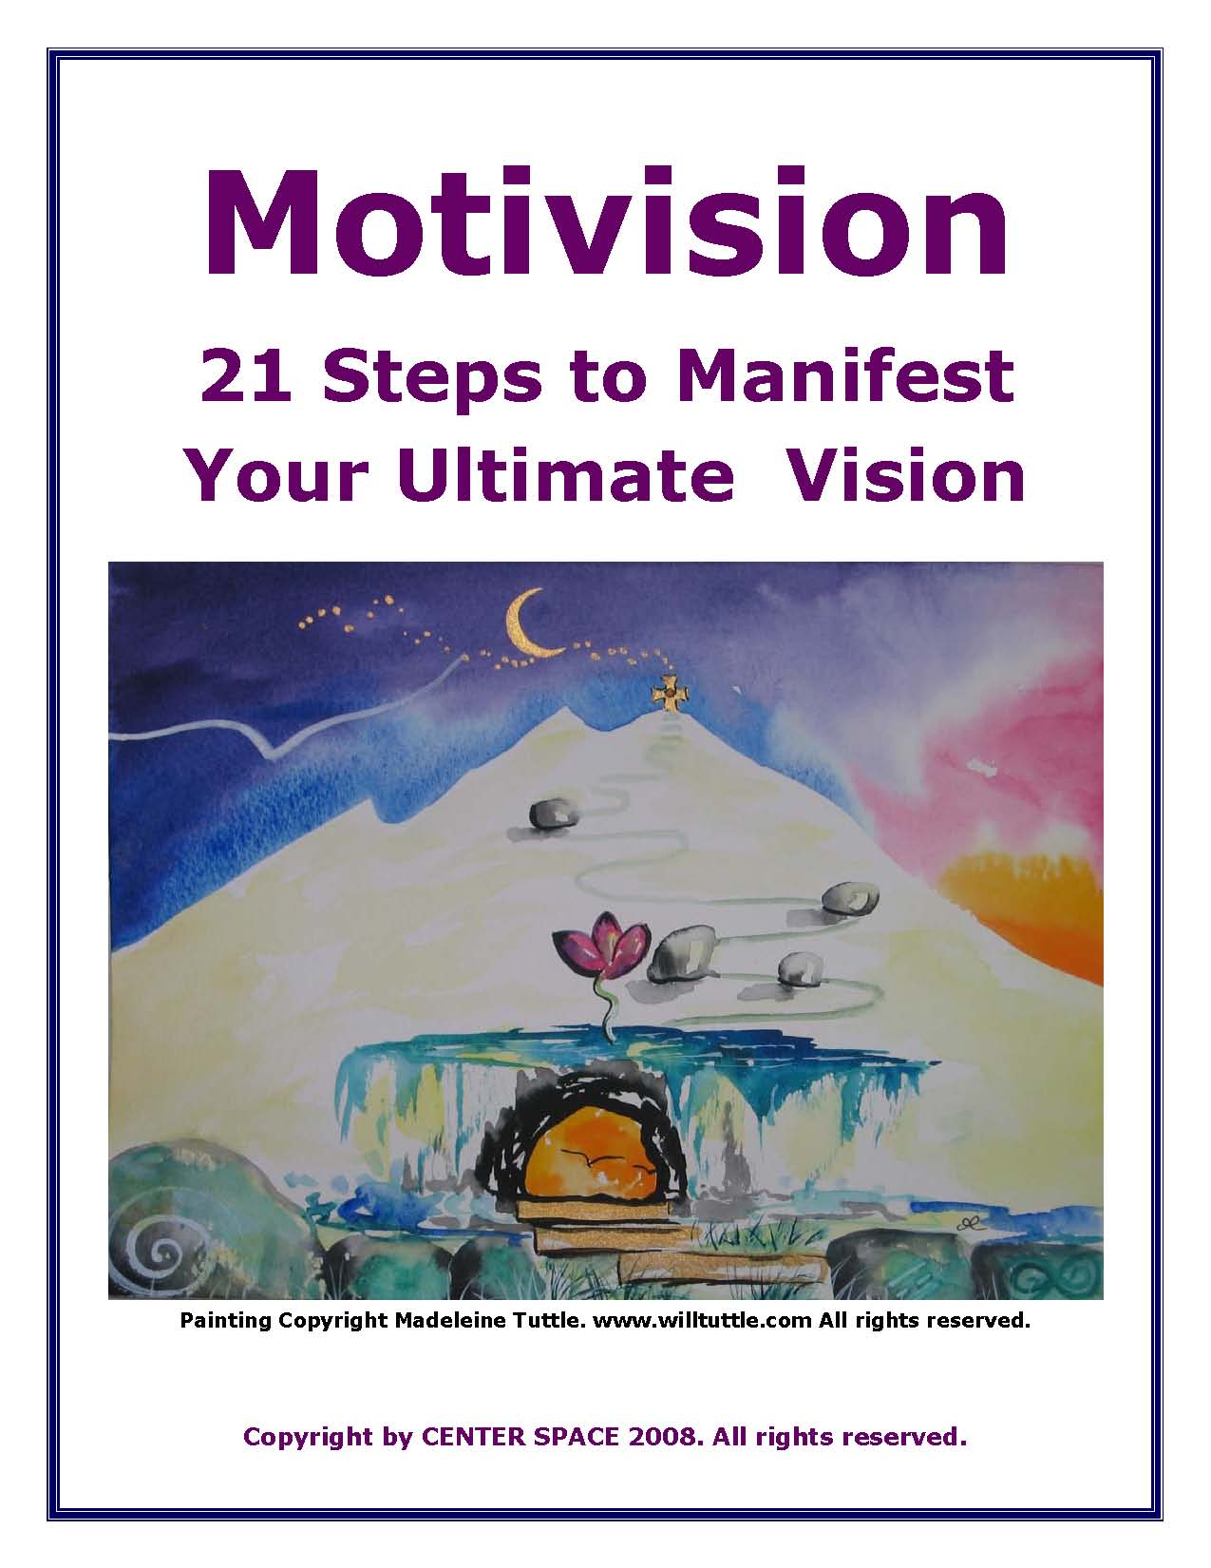
Motivision: Three Primary
Factors in Successful Living
Clarity of Your Vision
Definite Purpose
Appropriate Beliefs, Attitudes and Actions

Slide 19
Motivision™
After 25 years of studying and applying various success principles and techniques, we have observed that there are three primary factors that determine the level
of success we realize in life as individuals, organizations, and communities.

Slide 20
Motivision™
  The Three Factors of Success are:
CLARITY OF YOUR VISION
DEFINITENESS OF YOUR PURPOSE
APPROPRIATENESS OF YOUR BELIEFS, ATTITUDES AND ACTIONS

Slide 21

Motivision™
      DEVELOPING A CLEAR VISION

Slide 22
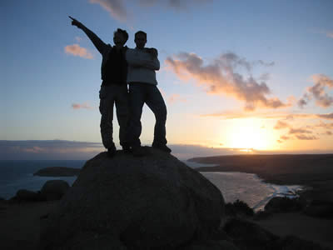
Motivision™
1. Invest time reflecting on your ultimate vision of who you would like to become, what you would like to do and what you would like to leave as your legacy to humankind.

Slide 23

Motivision™
      2. Develop affirmations describing yourself as already having achieved the visions developed above.

Slide 24

Motivision™
3. Practice visualizing the accomplishment and realization of your vision on a daily basis, as frequently as possible.

Slide 25

Motivision™
4. Practice generating the feelings and emotions you will experience when you have achieved each component of your ultimate vision.

Slide 26
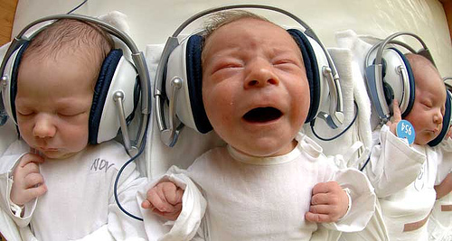
Motivision™
5. Reinforce your belief by using books, scriptures, quotes, audio video tape program, seminars, etc. that help increase your belief that you will ultimately achieve your highest possible vision.

Slide 27

Motivision™
6. Practice daily exercises to help you remember your vision and maintain progress toward its fulfillment.

Slide 28

Motivision™
7. Establish a regular practice of reviewing the basis upon which your vision has evolved to discern any possible refinements or revisions.

Slide 29

Motivision™
MAXIMIZING DEFINITENESS
OF PURPOSE

Slide 30

Motivision™
1. Invest time in learning how to set and achieve goals for who you would like to become, what you would like to contribute to and do, and what you
would like to have or give to others

Slide 31
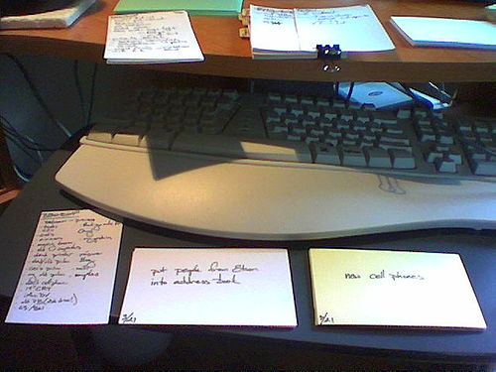
Motivision™
2. Develop a list of the reasons why you have set each of your goals. This will help keep you motivated to accomplish them.

Slide 32

Motivision™
3. Develop written affirmation statements describing the successful manifestation of your goals in a positive present tense such as “I am . ..“ or “I have...”.

Slide 33

Motivision™
4. Put your goals and affirmations in writing, perhaps on index cards you can keep with you at all times.

Slide 34

Motivision™
5. Practice reading and visualizing your goals cards as frequently as possible every day and maintain a regular practice of reviewing and rewriting your goals to reflect progress toward their fulfillment and evolution of your vision. This reinforces your belief in your ability to be successful in accomplishing your goals.

Slide 35

Motivision™
6. Generate daily reinforcement by subscribing to publications with daily readings such as the Daily Word, Science of Mind, Creative Thought and or get books like The Power Within and God Calling which also provide daily inspiration and insight to help you keep your eyes lifted up toward your vision.

Slide 36

Motivision™
7. Develop a daily habit of reflecting on
how well you remained conscious of and focused on your goals during each day in every interaction you had with anyone else.

Slide 37

Motivision™
MAINTAINING APPROPRIATE BELIEFS, ATITUDES AND ACTIONS

Slide 38

Motivision™
1. Develop and maintain a Positive Mental Attitude. Get around positive people, positive materials and positive experiences.

Slide 39

Motivision™
2. Be grateful in all things! View every situation as an opportunity to grow and progress toward your vision and goals.

Slide 40

Motivision™
3. Remember in every situation that it is not what happens to us, but how we let it affect us, that determines our success or failure in life. Learn and practice the principles of creative thinking and problem solving.

Slide 41

Motivision™
4. Learn and practice time management techniques to assist you in making the highest and best use of your time, talents, resources and opportunities. For example, the 80-20 Rule which says that 80 percent of the results or importance in any project will be produced by 20 percent of the activities. Determine which are the crucial 20 percent and focus on them.

Slide 42

Motivision™
5. Develop and follow a process of analyzing your planned actions within
a context or matrix that takes into consideration your ultimate goals, values and priorities. This exercise makes it easier to discern and choose those thoughts and actions that will lead you toward your vision and goals.

Slide 43

Motivision™
6. Remember that everything you do,
say or think either moves you toward your vision and goals or away from them. Your greatest power is the power to determine your own ultimate destiny by the daily choices you make.

Slide 44

Motivision™
7. Practice a “ Mindstorming Exercise”, every day to generate 20 ideas that will help you evolve toward your vision and goals. This exercise which includes the development and implementation of daily action plans, can accelerate your progress and success in realizing the achievement of your highest possible vision and ultimate destiny.

Slide 45


Slide 46
Four Questions To Ask Yourself
In Granting Your Own Wishes:
What do you really want or wish for?
Why do you want it?
How will your life change
when you have it?
Are you still sure you want it?

Slide 47
OUTCOME SUCCESS MAP
What is My Desired Outcome? (What do I want?)
Describe in detail, with clarity and precision.
To help you, what will the end result look like?
What will it sound like? When achieved, what will it feel like to you?

Slide 48
OUTCOME SUCCESS MAP
What will I need to do to achieve my Desired Outcome? (What will I do?)
What action will I take?
What strategies will I use to get what I want?

Slide 49
OUTCOME SUCCESS MAP
What inner resources will I need to carry out the strategies I listed in 2?
Attitudes
Skills
Knowledge

Slide 50
OUTCOME SUCCESS MAP
4. How will I know when I am successful? (How will I know?)
(What feedback will I accept from the world that verifies I have achieved what I set out to create as my Desired Outcome?)

Slide 51
Golden Bridge Exercise Adapted from Helping Heaven Happen by Donald Curtis
(3) List Your Assets
(4) List Steps To Get There
(2) Present Situation
(1) Ultimate Destination
(5) Review Your Lists and Set Priorities

Slide 52
9 Principles of Manifesting Your Destiny
Become Aware of Your Highest Self
Trusting Yourself is Trusting the Wisdom That Created You
You are not an Organism in an Environment: You are an Environorganism
You Can Attract to Yourself what you Desire
Honoring Your Worthiness to Receive

Slide 53
9 Principles of Manifesting Your Destiny
Connecting to the Divine Source with Unconditional Love
Meditating to the Sound of Creation
Patiently Detach from the Outcome
Reacting to Your Manifestations with Gratitude and Generosity
Excerpted from Manifest Your Destiny Workshop
by Gerrie Sidwell of Sedona Teaching based on
Wayne Dyer’s book, Manifest Your Destiny

Slide 54
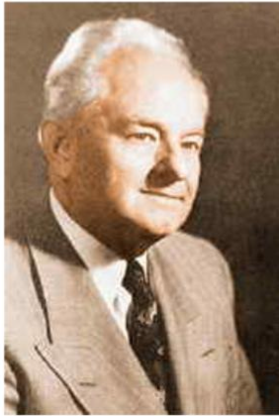
“It has taken humanity thousands
of years to learn that it has the
power to control its own destiny.”
Ernest Holmes

Slide 55
The 5 Steps of Spiritual Mind Treatment
“We have within us a power that is greater than anything that we shall ever contact in the outer, a power that can overcome every obstacle in our life and set us safe, satisfied and at peace, healed and prosperous, in a new light, and in a new life.” Ernest Holmes
There is a Creative Power for Good and I use it!
Recognition, there is One Power
Unification, I am this Power
Realization, it is already so
Thanksgiving, I feel grateful
Release, I let go and so it is
www.CreativePowerForGood.com

Slide 56
What does ultimate
destiny mean to you?

Slide 57
Six Steps In Fulfilling
Your Ultimate Destiny
(1) Imagine Your Ultimate Destiny
(2) Envision Your Desired Outcomes
(3) Nurture Your Heart’s Desires
(4) Set Empowering Priority Goals
Develop Plans and Take Action
Feel Grateful and Appreciative

Slide 58

What is Your Ultimate Destiny?
What is your greatest desire?
What is your ultimate purpose in life?
What is the most magnificent dream you have?

Slide 59
What facets of co-creating your ultimate destiny are most important to you?
Realizing Your Ultimate Potential | Fulfilling Your Life Purpose and Mission
Enjoying Loving Relationships | Attaining Financial Freedom and Prosperity
Enjoying Ultimate Health and Fitness | Achieving Ultimate Business Success
Raising Your Consciousness Level | Enjoying Peace and Balance
Harnessing Your Creative Mind Power | Attaining Spiritual Enlightenment
Making A Difference Leaving A Legacy | Fostering Personal and Global Sustainability

Slide 60
Ultimate Destiny Wheel of Life
Step 1: Review the six areas of the Ultimate Destiny
Successful Living Wheel. Think about what would
be ultimate for you in each area of successful living.
Step 2: Determine which area is most important to you
right now and put a #1 by it. Then put a #2 by the second
most important and continue for each of the six areas.

Slide 61
Prioritize the Areas of Life
___ Wellness, Fitness &
Well-Being
___ Other Relationships
___ Spiritual Growth &
Enlightenment
___ Personal Growth &
Development
___ Family & Home
___ Wealth, Prosperity,
Finances & Career
3
2
1
Notes:
Now that you’ve identified what is ultimate for you in each of the six areas, the next step is to determine which area is most important to you right now. You can identify this by putting a #1 on the line next to the area title on the handout you printed at the beginning of this exercise. Next, put a #2 by the second most important and so on for each of the 6 areas. Each area will be identified by numbers 1 through 6 based on their importance to you.

Slide 62
Ultimate Destiny Wheel of Life
Step 3: Think about how satisfied you are at the present
time with where you are with each one of the six areas
and rank them on a scale of from 1 low (if you are totally dissatisfied) to a high of 10 if you are totally satisfied.)
Place a mark on each spoke of the wheel to indicate your
level of satisfaction with 1 low near the center and 10 high
at the outer rim.

Slide 63
Is your wheel balanced?
Would it roll?
Notes:
Let’s see how balanced your wheel is. You’ve just had an opportunity to determine what is ultimate for you in each of the six areas and have identified the areas in order of importance. Now let’s turn our attention to the present. Look at each of the six areas again and think about how satisfied you are with where you are at with each area and rank them on a ten point scale with 1 being low (if you are totally dissatisfied) and 10 being high (if you are totally satisfied). On your handout, you’ll notice there are little grooves on each spoke of the wheel (these need to be more noticeable when the material is printed). Once you’ve determined your satisfaction level, place a mark on the spoke to indicate this with 1 near the center and 10 at the outer rim. After you have recorded a satisfaction level for each spoke, connect the dots. Is your wheel balanced? (mouse click) Would it roll or are there some areas that need work? Don’t panic if your wheel looks like anything but a wheel. This happens for most people. Our goal in this exercise is to help you bring the various aspects of your life that are out of balance, back in balance. In order to do this, it’s important to have an understanding of where you are currently.

Slide 64
Which of the 12 Facets of Achieving Your
Ultimate Destiny Are Most Meaningful To You?
Rank # ____ Achieving Personal Growth and Realizing My Potential Priority # ____ (1 Low - 10 High) | Rank # ____ Enjoying Ultimate Health and Well-Being Priority # ____ (1 Low - 10 High) | Rank # ____ Fulfilling My Life Purpose, Mission and Goals Priority # ____ (1 Low - 10 High) | Rank # ____ Harnessing My Creative Power and Subconscious Mind Priority # ____ (1 Low - 10 High)
Rank # ____ Achieving Ultimate Success in My Business or Career Priority # ____ (1 Low - 10 High) | Rank # ____ Enjoying Loving, Positive Supportive Relationships Priority # ____ (1 Low - 10 High) | Rank # ____ Acquiring Financial Freedom and Prosperity Priority # ____ (1 Low - 10 High) | Rank # ____ Enjoying Peace and Balance in All Areas of Life Priority # ____ (1 Low - 10 High)
Rank # ____ Raising My Levels of Consciousness Priority # ____ (1 Low - 10 High) | Rank # ____ Attaining Spiritual Enlightenment Priority # ____ (1 Low - 10 High) | Rank # ____ Making A Difference, Leaving A Legacy Priority # ____ (1 Low - 10 High) | Rank # ____ Fostering Personal and Planetary Sustainability Priority # ____ (1 Low - 10 High)

Slide 65
Pick one Priority area
to complete the next exercise on.
Find the Self-Assessment form for
that area and complete the exercise.

Slide 66
What don’t you want in this area?
What I DON’T Want:
To feel sick
Be overweight
Clothes that don’t fit
Feel fat
Notes:
Look back at the sheet you created in Step 2 where you prioritized each of the six areas according to what is most important to you right now. Find the area with the number 1 next to it, the one you labeled as most important. Then, locate the Discovery Exercise Sheet for that area that you printed before you began the exercise. For example, if you identified Family and Home as number 1, locate the sheet that says, “Family and Home” in the title box of the second column. We are going to spend the next few minutes completing the form. We’re going to start by identifying what you don’t want in this area. This may sound rather silly. “Why would I list what I don’t want?” you may wonder. Even though it seems counterproductive, it is really a very helpful technique. Most people can easily identify what they don’t want in their life and have a harder time identifying what they do. Once you’ve determined what you don’t want, then you just look at the opposite of what you’ve listed and you’ve got what you do want. Starting in the first column on the left, list what you don’t want in this area. Then, list what you do want in the next column. Pause the recording until you’ve finished writing your thoughts.

Slide 67
What do you want in this area?
What I DO WANT:
To feel healthy
At my ideal weight
Wear my favorite jeans
Feel lean
Notes:
Look back at the sheet you created in Step 2 where you prioritized each of the six areas according to what is most important to you right now. Find the area with the number 1 next to it, the one you labeled as most important. Then, locate the Discovery Exercise Sheet for that area that you printed before you began the exercise. For example, if you identified Family and Home as number 1, locate the sheet that says, “Family and Home” in the title box of the second column. We are going to spend the next few minutes completing the form. We’re going to start by identifying what you don’t want in this area. This may sound rather silly. “Why would I list what I don’t want?” you may wonder. Even though it seems counterproductive, it is really a very helpful technique. Most people can easily identify what they don’t want in their life and have a harder time identifying what they do. Once you’ve determined what you don’t want, then you just look at the opposite of what you’ve listed and you’ve got what you do want. Starting in the first column on the left, list what you don’t want in this area. Then, list what you do want in the next column. Pause the recording until you’ve finished writing your thoughts.

Slide 68

What are the ultimate possibilities?
Notes:
Often when we identify what we do want, whether we do it consciously or not, we tend to hold back a little, keeping reality in check. In this next column though, I want you to put reality and any other restriction aside and imagine what the ultimate possibilities for you in this area might be. For example, if you listed a new home as one of your wants, what could be the ultimate dream home for you? What kind of home? Where is your home located? If you listed a new career as one of your wants, what type of career would be ultimate for you? What’s your ultimate salary. The key here is to dream without holding back. Pause the recording and list your ultimate possibilities on the form.

Slide 69

How will you feel when you have all you want in this area?
Notes:
Next, spend a few minutes imagining what feelings and emotions you will experience when you realize the ultimate possibilities you just listed. Do you feel incredibly happy, successful, abundant? Whatever feelings or emotions are created for you, be sure to take a minute and really feel as if you are enjoying this ultimate possibility, trying to involve as many of the senses as possible. Enjoy those feelings for a moment and then record them in the Step 6 box. Emphasizing the importance of feelings, Michael Bernard Beckwith said, “This is a feeling Universe. If you just intellectually believe something, but you have no corresponding feeling underneath that, you don’t necessarily have enough power to manifest what you want in your life. You have to feel it.”

Slide 70
See, Feel, Believe and Trust!
“Decide what you want. Believe you can have it. Believe you deserve it and believe it’s possible for you. And then close your eyes every day for several minutes, and visualize having what you already want, feeling the feelings of already having it. Come out of that and focus on what you’re grateful for already, and really enjoy it. Then go into your day and release it to the Universe and trust that the Universe will figure out how to manifest it.” – Jack Canfield
Notes:
We’ve talked a lot about the importance of seeing, feeling and believing. Jack Canfield does a great job of summarizing the importance of these three for us in his quote on the screen.

Slide 71


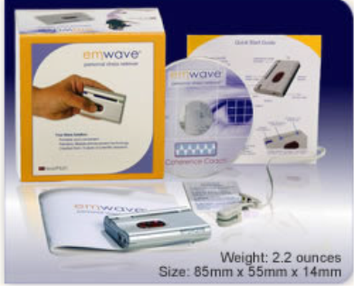
How Will You Nurture
Your Heart’s Desires?
Freeze Framer from HeartMath®
Emwave from HeartMath®
Notes:
Just as a plant cannot thrive if it is not properly fed and nurtured, the same is true of your ultimate desires. They need to be nurtured and given the opportunity to grow. In the next column, list ways you will reinforce your ultimate desires. For instance, if your ultimate desire is to be concert pianist, one way you could nurture your desires is to surround yourself with piano music that inspires you. You could listen to it while driving to or from work, while you get ready in the morning, or while preparing your evening meal. It’s also essential that you surround yourself with supportive people who are cheering you on to accomplishing your desire. We’ll talk more about this in Step 11. But what tends to happen for many people is that they have sense of what they desire to accomplish or do, their destiny if you will, and then they share this dream with someone else, maybe a close family member or friend. Generally our family or friends are not trying to deliberately sabotage our dreams, but most likely they have been through the pain of having their own dreams squashed and in an effort to help us avoid such hurt, they may discourage us from pursuing our dream, telling us it would take too much money, or that it’s too dangerous or too hard and that we really should do something much safer and sensible. This is why it is vitally important that you protect your dreams and desires by actively nurturing them. See yourself accomplishing and living your dream. Surround yourself by successful people living their dream. Read inspirational accounts of men and women in history who conquered great odds to accomplish their dreams. Record the methods you will use on your sheet now.

Slide 72
What Priority Goals Will You Set?
Notes:
Our ultimate desires will remain desires unless we take the necessary action steps that will allow them to be realized. These action steps are identified as priority goals. In the next column, set 2 to 3 priority goals that will help you realize your ultimate desire. For a goal to be most effective it should be a SMART goal with the following components: Specific, Measurable, Aligned, Realistic, Time-dated. For instance, let’s go back to the concert pianist desire. If this was your desire, your goal could be to practice for a minimum of 4 hours a day, 5 days a week for the next 60 days. This goal is specific (practice the piano), realistic (need to reach goal), measurable (4 hours a day, 5 days a week) and time-dated (next 60 days).

Slide 73
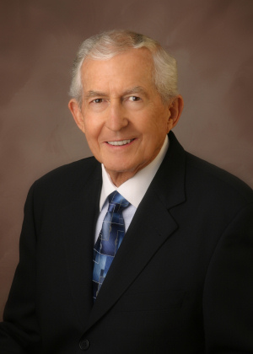
“Each of us is born to shape a
personal destiny. The depth and extent
of that destiny are measured by
the personal goals we set.”
Paul J. Meyer

Slide 74

What Obstacles and Hurdles
Will You Need to Overcome?
Notes:
There is a universal principle of opposition in all things, including the realization of our ultimate desires. As you work towards achieving your ultimate desire, undoubtedly there will be challenges and obstacles you will have to overcome. But, don’t let this discourage you. Rather, embrace the challenges and obstacles, gratefully acknowledging they are for your benefit and will only make you stronger. Also, anticipating what challenges or obstacles may arise, makes them seem not quite so daunting when they do come because you are not surprised. Instead, you are prepared to deal with them. Pause the recording and take a minute now to list any challenges or obstacles you foresee in achieving your ultimate desire. For example, an obstacle to the concert pianists goal of practicing 4 hours a day, 5 days a week may be the probability of being asked by work to attend an out of town sales conference for a week without access to a piano. Once this possible obstacle is identified, the next step is to identify solutions and ways to overcome it.

Slide 75
Never “Throw in the Towel”
“…[People] say, ‘I’m fired up. I saw this program and I’m going to change my life.’ And yet results aren’t showing. Beneath the surface it’s just about ready to break through, but the person will look just at the surface results and say, ‘This stuff doesn’t work.’ And you know what? The Universe says, ‘Your wish is my command,’ and it disappears.”- James Ray
Notes:
Also, it’s important to remember that just because you can’t see the progress or exact results that you want right now, doesn’t mean that things aren’t happening. Take a look at this quote by James Ray. Realize that you are making HUGE changes in your life. You are releasing habits, thought patterns, and beliefs that no longer serve you and replacing them with more positive, supportive ones. Give the process time to work and establish solid roots. Hold firm to your vision and work towards, seeing only the end from the beginning. The part in the middle will take care of itself.

Slide 76
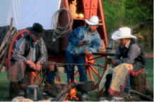
Who Will Be Your Coaches,
Mentors and Mastermind Partners?
Notes:
Have you ever spent an evening sitting around a campfire? Maybe you had a marshmallow roast or enjoyed swapping stories with friends and family. If you think about it, there are some interesting lessons we can learn from a campfire. First, consider how a campfire is made. You can’t toss two or three big logs into a pit and expect them to catch fire and burn. Rather, you need to surround the bigger logs with kindling, something that will catch fire and burn easily, giving the bigger logs time to catch fire. And yet, if you only used kindling you would have a great fire, but it wouldn’t last very long. By combining kindling with bigger logs, you get a beautiful fire that is a source of abundant light and warmth. Secondly, the logs in the fire feed off each other. If you were to pull a log from the flames and set it off to the side by itself, away from the source of heat, the embers within the wood would quickly cool and burn out. There is nothing to keep the flames burning. In these next two steps of our process we are going to apply the lessons we learn from the campfire. First, you need someone who can act as kindling in your life, who can take the spark within you, the spark that whispers your ultimate destiny and help you turn the spark into a vibrant flame. This person who can help you do this is a coach or mentor, someone trained to help you overcome your fears, show you how to proceed down the path and hold you accountable for your actions or inactions. The role of a coach or mentor is invaluable in this process. Do you know someone who would be a great coach or mentor for you? If so, write his or her name in the next box on your sheet. If you don’t have anyone in mind, contact a member of the Ultimate Destiny team at the end of this presentation and ask to be connected with a Successful Living Coach.

Slide 77

Who Will Be Your Cheerleaders?
Notes:
Continuing with our campfire analogy, this next slide identifies the big logs in your life, your cheerleaders. The ones who keep you motivated and support you in the quest for your dream. If you try to do it alone, you will eventually burn out. You need their energy, encouragement and insight. Napoleon Hill discovered that the most successful people he studied, had a Master Mind Team, a team of people they could count on for support, ideas, contacts and resources to try. Whether your support team is in the form of a Master Mind Team or simply family or friends who believe in your dream and want you to be successful, it’s most important that you have a team behind you. Take a moment now and identify the individuals in your life who might be able to be your cheerleaders and support team by writing their names in the box for Step 11.

Slide 78

What Action Steps Can You Take?
“Work is the miracle by which talent is brought to the surface and dreams become a reality.” –Gordon B. Hinckley
Notes:
As we talked about before, a dream will remain a dream, unless we take action and allow it to become a reality. Gordon B. Hinckley said, “Work is the miracle by which talent is brought to the surface and dreams become a reality.” Now, don’t let the work “work” scare you. Most often the word “work” is associated with something unpleasant, hard or possibly boring. And yet, those are all connotations individuals have attached to the word. The definition of work is simply a means of action that produces a result. No where is it recorded by law that “work” must be unpleasant, hard or down-right boring. Actually, work, especially that associated with your dream can be inspiring, enjoyable and if we may be so bold, fun!! In this next step, take a few minutes now to identify at least 2 or 3 actions steps you can take to achieve your goals and desires in this area of your life. One thing to note is that as you progress and complete other areas on the Ultimate Destiny Wheel, you will want to review what you have written for each area and consider if there are ways that your progress in one area could be combined with or leverage progress in another area. For example, you could combine a relationship area with a wellness area by working out together with someone you’d like to spend more time with.

Slide 79
What Affirmations Could You Use?
"Do" - "Be" - "Have"
"Be" - "Have" - "Do"
Notes:
Earlier we talked about the importance of feelings, really feeling the emotions you would feel if you were enjoying your dream or what you want in this particular area. In these next two steps, we are going to talk about two other very important condition of you being able to see your desires materialize. They are affirmations and visualization. We will talk about affirmations first. Defined, affirmations are positive tense statements of the present manifestation of your future vision. “What does that mean,” you may be wondering. Glad you asked! Basically affirmations help you reinforce belief. They are a positive statement of what you want as if you were enjoying it right now. For example, let’s suppose your ideal weight is 138. An affirmation for this could be, “I look great at 138.” Now, you may not be 138 pounds at the present moment, but that’s the point. In order to be 138, you first have to be 138 in your mind and heart, regardless of what the scale says. Typically we think we have to DO something to BE someone to HAVE something. But, this is backwards. We first need to BE something, then we will HAVE something and finally we will DO something. Be the thing first and the rest will follow. This is why affirmations are so important because in them we affirm what it is we want as if we had it or were it right now. Let’s look at a few more examples of affirmations: 1. “I am a highly successful salesperson who regularly exceeds monthly sales quotas.” 2. “I am patient, kind and loving with my children and spouse.” 3. “I am lovable as I am.” Now it’s your turn. Take a few minutes now to record one or two affirmations you can use to support you in manifesting your desire for this area of your life. Affirmations are most powerful when they are said often, at least daily. We highly recommend that you write your affirmations on 3x5 cards or sticky-notes and hang them where you will see them often. Saying your affirmations doesn’t need to be a huge time issue. Look for the cracks in your day when you could squeeze them in. For instance, repeat your affirmations in your head while you’re brushing your teeth or preparing lunch for your kids. Be creative! W. Clement Stone said, “Whatever the mind…can conceive it can achieve.” What can you conceive?

Slide 80




What Visual Images Will Help You
Remember and Realize Your Vision?
Notes:
Next, let’s talk about the importance of visualization. In this step, you are going to identify visual images you can use to help you hold your vision and achieve what you desire. The power of visualization is perhaps one of the most important “secrets to success.” Studies have shown that your mind doesn’t know the difference between actual experiences and imagined ones. When you can see yourself achieving what you want to accomplish in your mind and believe it, really believe, you are planting the seeds for your desire to manifest. Albert Einstein said, “Imagination is everything. It is the preview of life’s coming attractions.” Take a moment now to record what visual images you will focus on to achieve your dream. For example, if your desire is to have a new career, you could imagine yourself walking into your new place of employment and going to your workstation to begin your day. Or if your desire is to have $50,000 in your savings account, you could imagine yourself opening your bank statement and seeing that the balance is $50,000. Doing the visualization exercise as you go to sleep is especially powerful as your subconscious will hold onto the images and go to work to bring them about.

Slide 81

Transfer Your Priority Goals to the Master Goals Sheet
Notes:
Before any building is constructed, an architect creates a blueprint, a master plan if you will. Otherwise, can you imagine the chaos, waste and potential harm done if there was not a plan? The importance of a master plan applies to setting goals as well. You’ve done a lot of work and have many thoughts, goals, affirmations, and feelings identified. Now, it’s time to review each sheet and look for the top priorities, those things that you can focus on for the next 30 days to propel your dream forward. Take these items and transfer them to your master goal sheet. How many items you transfer is up to you. Of course we recommend that you don’t overwhelm yourself with too many goals. Pick what’s comfortable to you and realistic given your situation in life. You can create a master goal sheet for each of the six areas combined on a single goal sheet or you can create a master goal sheet individually for each of the six areas resulting in a six master goal sheets. Again, do what’s fits your needs and personality the best. The main objective is that you have a master plan, something that you can go to work on today!

Slide 82

Review Your Goals Frequently and Enjoy the Feelings You Will Feel!
Notes:
As we finish up, let’s consider a few things. First, review what you have discovered through this exercise as often as possible. Take time to envision and enjoy in your mind the realization of your goals and dreams in each area of life. Also, as you review, create new master goal sheets anytime you’ve accomplished the items you recorded or need to modify. Reviewing and updating your goal sheets is an important and invaluable step that keeps you motivated and joyous as you make your way towards your Ultimate Destiny!

Slide 83

Practice Meditation and Prayer
Notes:
Two additional actions that will greatly assist you in achieving your desires and destiny is meditation and prayer. Research has proven that prayer and meditation are two of the most powerful and practical ways you can live a happy, fulfilling and successful life. We highly recommend that you meditate and pray everyday. Again, this doesn’t need to take huge amounts of time. Work with what you’ve got available and then watch the difference it makes in your life. (If you are new to meditation or prayer Treatment, please visit the Ultimate Destiny website for resources that will teach you how to meditate and pray.)

Slide 84

Radiate Gratitude! Be Grateful In
All Things to Attract Your Desires!
Notes:
Finally, be grateful for all the rich blessings showered upon you and radiate love, peace, joy and thanksgiving to everyone and every situation. Research through the Institute of Heart Math has shown amazing empirical evidence showing the physiological changes in the body when experiencing emotions of love and appreciation. Simply being grateful for what is will open the doors for new things to come into your life. As Dr. John F. DeMartini says, “Whatever we think about and thank about we bring about.”

Slide 85
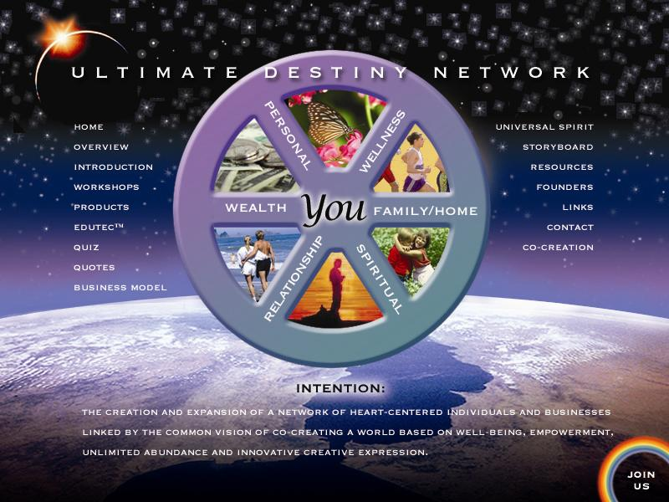
Helping individuals, organizations and communities realize more of their inherent potential in conscious and sustainable ways that expand the circle of success and foster betterment for humanity and earth stewardship.
Join the Ultimate Destiny Network
Notes:
This concludes the Wheel of Life exercise webinar. Thank you for joining us. All of us at Ultimate Destiny want to congratulate you on taking control of the wheel of you life and steering it in the direction of your dreams and desires. This is just the beginning of a very exciting journey. To help you along the way, we’d like to invite you to become a Charter Member of Ultimate Destiny. As such, you will receive your choice of any of three featured e-books: Creative Mind by Ernest Holmes, The Science of Getting Rich by Wallace Wattles or God Calling edited by AJ Russell PLUS receive a discount in becoming a Charter Member of the Ultimate Destiny Network where you will find a myriad of resources to help you along your course. We look forward to working with you and cheering you on. Here’s to you, your dreams and the unique contribution only you can make to our world.

Slide 86
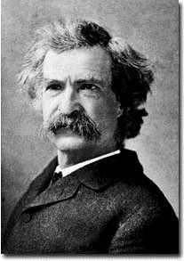
"Inherently, each one of us has the substance
within to achieve whatever our goals and dreams define. What is missing from each of us is the training, education, knowledge and insight to
utilize what we already have.“
~ Mark Twain

Slide 87
Ultimate Destiny’s Ultimate Vision
The shared vision of the individuals, companies and nonprofit organizations co-founding Ultimate Destiny is to help millions
of people Awaken to their spiritual identity, Realize more of their potential and
Know how to fulfill their ultimate destiny.
www.UltimateDestinyUniversity.com

Slide 88
Ultimate Destiny Helps
Shift Consciousness From:
Competition to Cooperation
Individual Effort to Team
Limited Thinking to Unlimited
Getting Success to Living Successfully
Personal Gain to Stewardship
Consumerism to Sustainable Living

Slide 89
Ultimate Destiny of Humankind,
The Ultimate Frontier!
"The acquisition of wealth is no longer
the driving force in the 24th century.
We work to better ourselves and
better all of humanity."
– Captain Picard
First Contact (Star Trek)

Slide 90
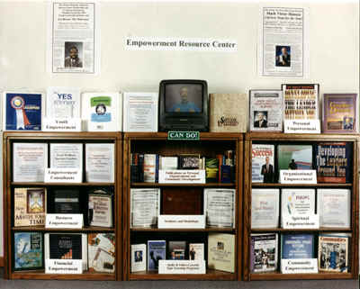
Ultimate Destiny Proprietary Programs
Empowerment Resource Centers ™
Empowerment Resource Showcases
and Empowerment Cabinets™
Centers for Successful Living ™
Expanding the Circle of Success ™
CAN DO! And Youth CAN DO!
Co-creative Community Visioning
and Strategic Planning Process
Certification of Successful Living Coaches ™ and Empower Mentors ™

Slide 91
Primary Distribution Network
10,000 + Empowerment Resource Centers ™
3,000 New Thought Centers, INTA, AGNT Etc.
Federal Agencies like HUD and HHS
3,500 Indian and Public Housing Authorities and Resident Organizations
5,000 United Way’s and Agencies
3,500 Community Development
Corporations and Action Agencies
500,000 Possible
Sponsors

Slide 92
Outcomes and Results
Helping Millions Of People To…
Awaken to their Spiritual Identity
Develop a larger
vision of themselves
Learn how to set
and achieve goals
Increase their performance levels
Discover and benefit from “New Thought” resources
Manifest stewardship
over financial resources
Fulfill their highest
possible destinies
Live happier, healthier
more productive lives!

Slide 93
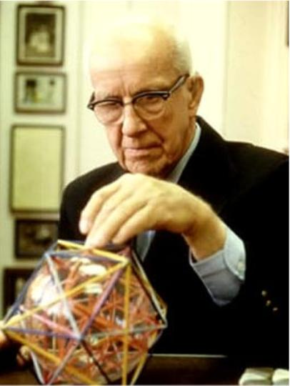
Bettertment for 100% of Humanity
“For the first time in history it is now possible to take care of everybody at a higher standard of living than any have ever known. Only ten years ago the ‘more with less’ technology reached the point where this could be done. All humanity now has the option to
become enduringly successful.”
– R. Buckminster Fuller, 1980

Slide 94
Ultimate Destiny Network
www.UltimateDestinyUniversity.com

Slide 95
Components of the Ultimate
Destiny Network
Ultimate Destiny University
Writers, Publishers, Producers Collaborative
CENTER SPACE (Center for Spiritual, Personal and Community Enlightenment)
See-Do-Now CAN DO!
Sedona Institute for Conscious Sustainable Living
The Light Center

Slide 96
Available Resources from
Ultimate Destiny Network
Co-creative Visioning and Strategic Planning
Publishing and electronic publishing
Marketing and public relations
Internet Marketing
Strategic alliances
Community and economic development
Fundraising (both grants and equity capital)
Repurposing content and programs

Slide 97
Present Areas of Needs by
Ultimate Destiny Network
Writing and editing * Research and development
Partners, sponsors and resource providers
Audio and video taping and editing
Web design * Article submission * Grant writing
Translating content into other languages
Facilities for holding seminars and workshops

Slide 98






Future Events with Scott and Shannon Peck of The Love Center
www.TheLoveCenter.com

Slide 99
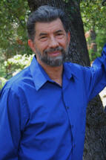






Future Events with Dr. Emmett Miller of The Light Institute
Awakening the Leader Within Workshop
Healing Our Planet Workshop
www.TheLightInstitute.com

Slide 100














Future Events with Jan and
John Randolph Price of Quartus
John Randolph Price and Jan Price are co-founders of the Quartus Foundation,
a research and communication organization formed in 1981.The Prices were originators of World Healing Day, a global mind-link for peace involving
millions of people that began on December 31, 1986, with the Los Angeles Times reporting up to 400-million participants. The Event has continued on the same date and time each year.
www.quartus.org

Slide 101
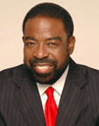

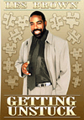





Future Events with Les Brown, “The Motivator”
Les Brown is an internationally recognized speaker and CEO of Les Brown Enterprises, Inc., he is also the author of the highly acclaimed and successful books, Live Your Dreams, and newly released book, It's Not Over Until You Win.
Les is the former host of The Les Brown Show, a nationally syndicated daily television talk show which focused on solutions rather than problems. In 1989, Les Brown was the recipient of the National Speakers Association's highest honor: The Council of Peers Award of Excellence (CPAE).
In addition, he was selected one of the World's Top Five Speakers for 1992 by Toastmasters international and recipient of the Golden Gavel Award. www.lesbrown.com

Slide 102


Expanding the Circle of Success ™
www.ExpandingTheCircleOfSuccess.org

Slide 103
Expanding the Circle of Success ™
Our overarching vision is to facilitate the realization
of potential by establishing an international network
of as many as 100,000 locally initiated Empowerment Resource Centers ERC's) and Empowerment Training Mentoring Systems (ETMS) by 2012.
Each ERC and ETMS will be staffed by certified Successful Living Coaches and Empower Mentors™ and supported through our Ultimate Destiny University for Successful Living.
www.ExpandingTheCircleOfSuccess.org

Slide 104
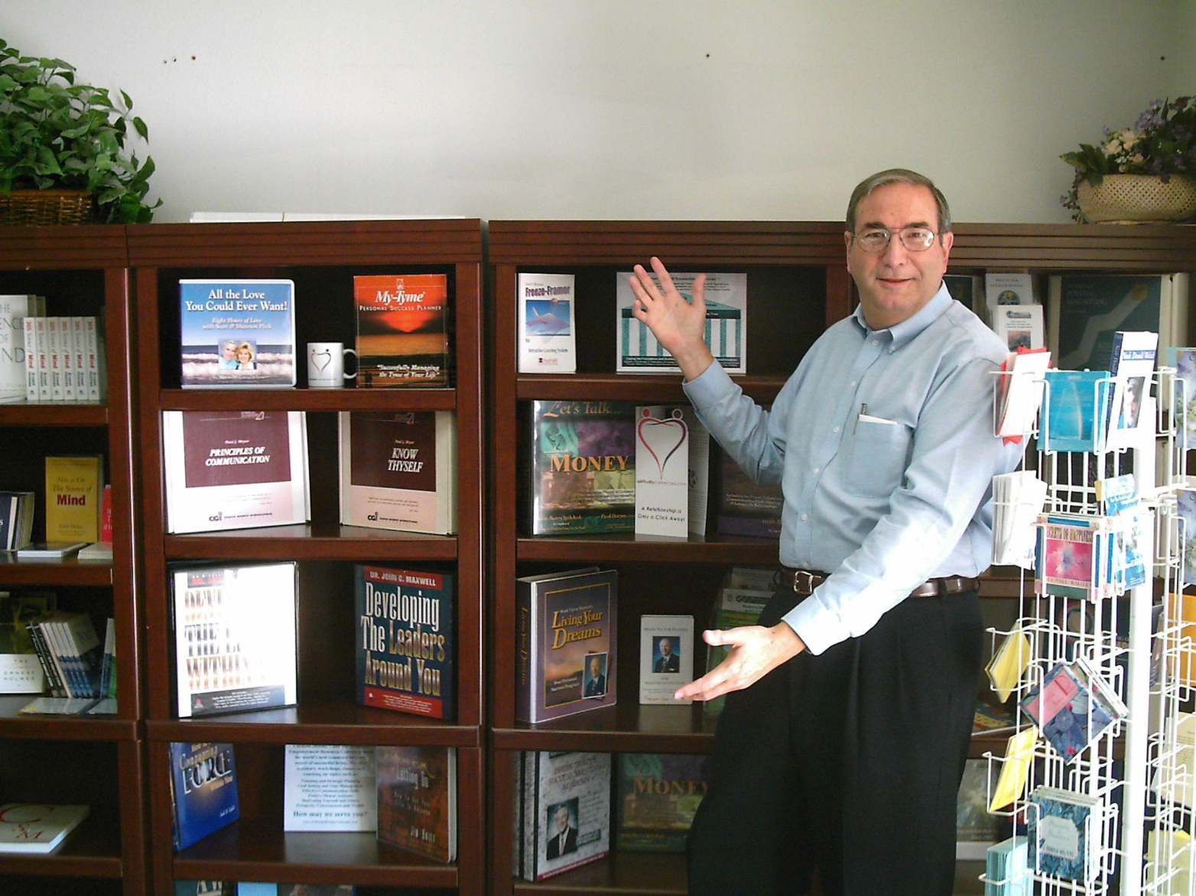
Empowerment Resource Centers ™
www.CanDoResourceCenter.com

Slide 105
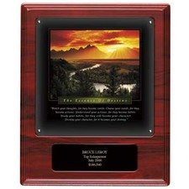
Ultimate Destiny
Hall of Fame Award
Honoring and Acknowledging
Individuals, Organizations and Resources That
Help People Realize More of Their Ultimate Destiny.
As a society, we have many well-known programs and
facilities to honor individuals who have excelled in sports, music, entertainment, business, etc.
Now Ultimate Destiny presents the Ultimate Destiny Hall of Fame Award to honor those individuals in any area of life who have manifested their ultimate destiny and especially those who
are also helping others manifest theirs.
www.UltimateDestinyHallOfFame.com

Slide 106


Programs Before and After Ultimate
Internet Marketing Training
Our initial product Expanded product after training
www.UltimateInternetMarketingResources.com

Slide 107
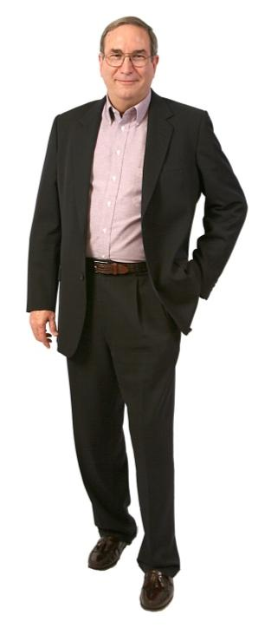
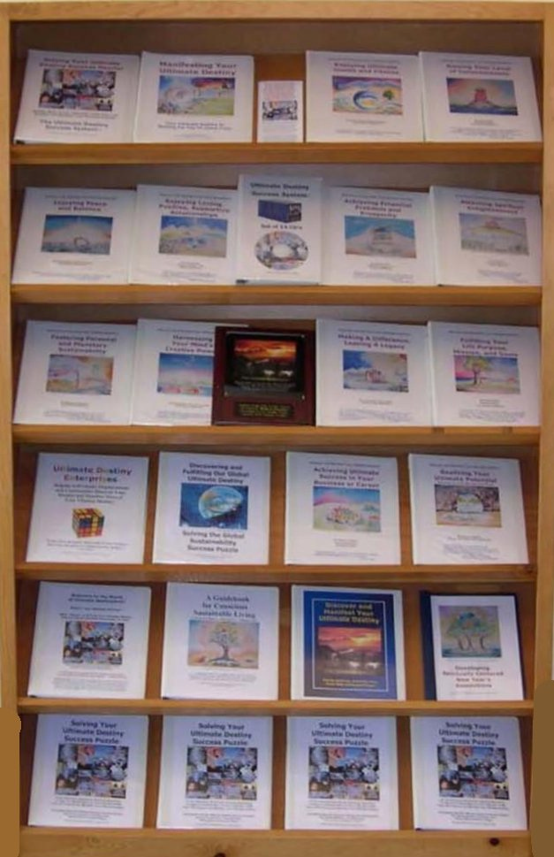
Printed UDSS fills a 6 foot book case!

Slide 108














Ultimate Destiny Success System™
The 14 part 1,000+ page Ultimate Destiny Success System includes:
Plus bonuses, webinars, teleseminars, and discounts on thousands of resources!

Slide 109
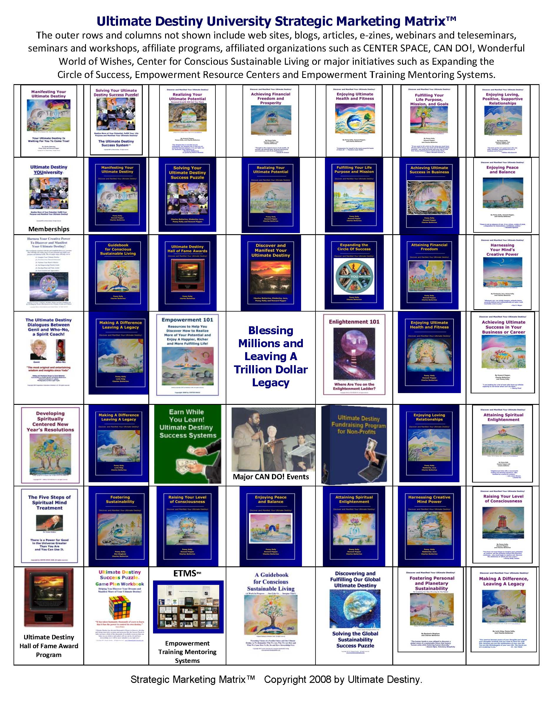
Ultimate Destiny Strategic Marketecture™

Slide 110

Your Non-profit Organization Can Prosper While Helping Others!
www.UltimateFundraisingPrograms.com

Slide 111

How Would You Like to Earn
An Income While Helping Others?
www.UltimateEarnWhileYouLearn.com

Slide 112

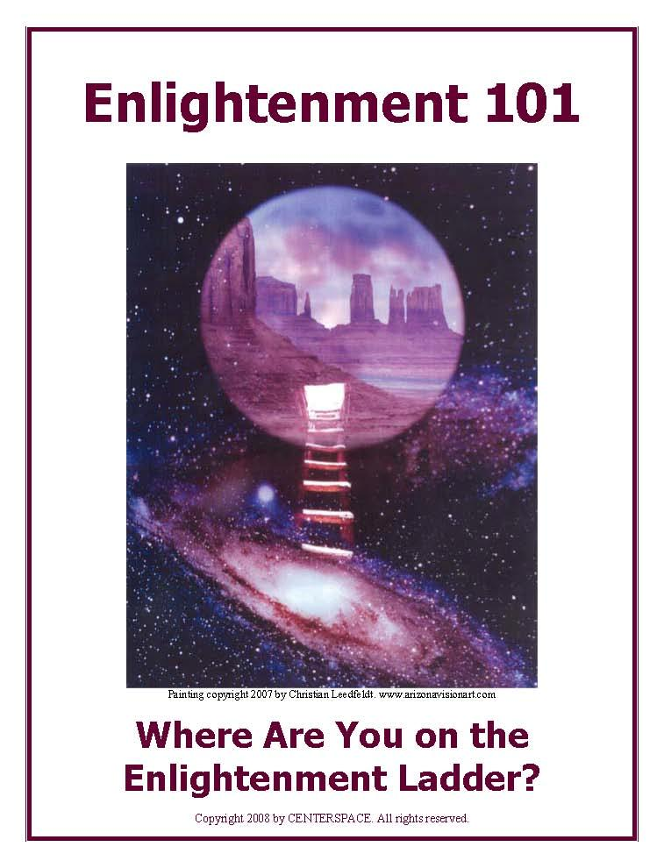
Two of your bonus e-books from Ultimate Destiny University!
www.UltimateDestinySuccessPlayshop.com/bonuses.htm

Slide 113
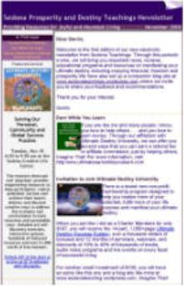
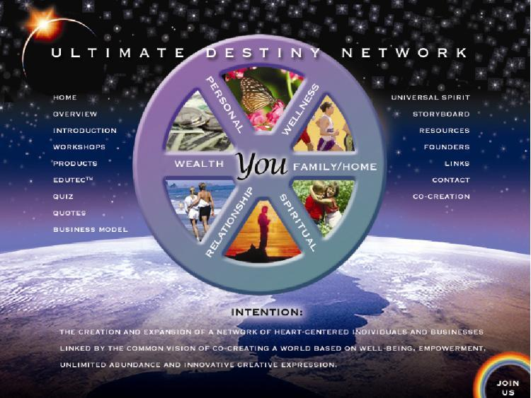
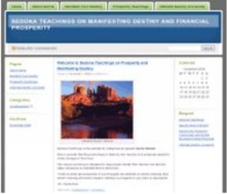
“Almost Instant” Internet
Marketing Affiliate Program
Charter Ultimate Destiny Affiliates receive your own wordpress blog, Ultimate Destiny site and your own Constant Contact E-zine set up!
www.UltimateDestinyUniversity.com/affiliate_program.htm

Slide 114
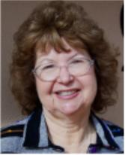

Charter Affiliate Marketing Member Gerrie Sidwell
Sedona Teachings is the website for metaphysical speaker Gerrie Sidwell. She is currently teaching workshops in Sedona. Her mission is to empower people to make changes in their lives.
Her unique workshop is designed to help people
identify their desires and take the steps necessary
to manifest them in their lives.
“What you think about expands. If your thoughts
are centered on what’s missing, then what’s
missing will have to expand. Nothing you
imagine in your mind is impossible. Dr. Wayne Dyer
www.SedonaTeachings.com

Slide 115
Have No Regrets
Survey of 4,000 Retired Executives Conducted by Gerald Bell, Professor of Organizational Behavior and Management, University of North Carolina at Chapel Hill.
The executives surveyed were an average of 70 years of age and were asked this question:
“If you could live your life over, what would you do differently?”

Slide 116
Their responses were as follows:
“I would have carved out life goals and owned my life.
Life was not just practice, it was the real thing. I should have taken charge of my life with goal-setting.”
“I would have taken better care of my health. I threw away health as though it were trash.”
“I would have managed my money a lot more effectively.”
“I would have worked on quality family goals a lot more.”

Slide 117
More Have No Regrets Responses
“I would have spent more time on personal development.”
“I would have had a lot more fun in my life.”
“Í would have planned my career.”
“I would have lived in oneness with my God and given more back to my community.”

Slide 118
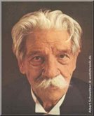
Service, Stewardship and Sustainability
“I don't know what your destiny will be,
but one thing I do know: the only ones among you who will be really happy are those who have sought and found how to serve.”
Albert Schweitzer

Slide 119
Successful Living Skills
for the 21st Century
Awakening to our spiritual identity.
Realizing more of our inherent potential.
Harnessing our creative mind power.
Flowing our energy to solutions rather than problems.
Remembering who we really are and why we are here.
Fulfilling our life purpose and mission.
Making a difference and leaving a legacy.
Loving, serving and blessing others.
Maintaining a positive mental attitude.
Applying creative thinking and problem solving.
Manifesting stewardship over the rich talents and
treasures entrusted to us by God/Spirit/Source/Creator.
www.crisisandopportunitypreparedness.com

Slide 120

This Is Only the Tip of the Iceberg!
In fact, this presentation has only covered about 5% of the 14-part, 1,000+ page Ultimate Destiny Success System!
www.UltimateDestinySuccessSystem.com

Slide 121
We invite your participation in whatever way best serves you!
__ Charter Member
__ Resource Provider
__ Sponsor/Donor
__ Trainer/Facilitator
__ Success Coach
__ Volunteer
__ Strategic Alliance Partner
__ Empowerment Consultant
__ Empower Mentor
__ Advisory Board Member
__ Investor/Revenue Share Partner
__ Co-produce & Sponsor Events
www.UltimateDestinyUniversity.com

Slide 122
For More Information Contact us at:
Ultimate Destiny University
PO Box 20072
Sedona, AZ 86341
ultimatedestinyuniversity@gmail.com
www.UltimateDestinyUniversity.com

